Slide 1
Biostatistics
Qian, Wenfeng

Slide 2
Myself
Qian, Wenfeng (钱文峰)
Institute of Genetics & Developmental Biology, CAS
Center for Molecular Systems Biology

Slide 3
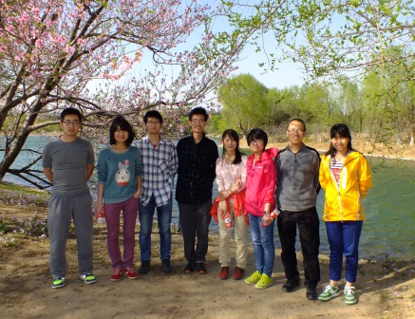
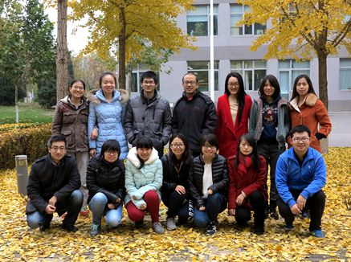
My group
http://qianlab.genetics.ac.cn/

Slide 4
My research
Single cell genetics
Variations among isogenic cells
Kinetics of gene expression
Protein synthesis/degradation
Transcriptional/translational burst
Quantitative functional genomics

Slide 5
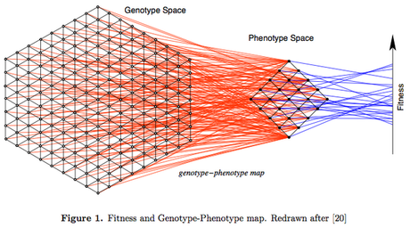
Genotype-Phenotype Map

Slide 6

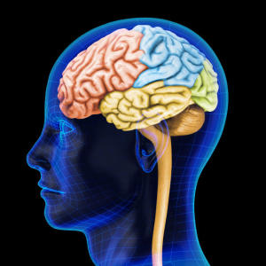
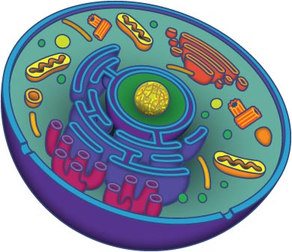
DNA coding rules
01101000 01100101
01101100 01101100
01101111 00100000
01110111 01101111
01110010 01101100
01100100
hello world
ATGCGCATATGCGCATTGCGCATATGCGCATG
………………
GCGCATATGCGCATG

Slide 7
My education
2006, B.S., Peking University
Biological Sciences
2012, Ph.D., University of Michigan
Evolutionary Genetics

Slide 8
Course introduction
Applied biostatistics
Examples, examples, and examples
Try to make it not too heavy

Slide 9
Statistics
Statistics is the study of the collection, organization, analysis, interpretation and presentation of data.

Slide 10
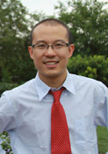
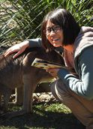
Schedule
March 21: Probability
March 23: Introduction to R
March 30: Hypothesis testing
April 1: Analysis of variance
April 6: Regression and correlation
April 11: Plots with R
April 19: Presentations (+ a report = final exam)
Shaohuan Wu

Slide 11
R language
Standard statistical tool in science
You will need to bring your laptop to the class, with R installed.

Slide 12
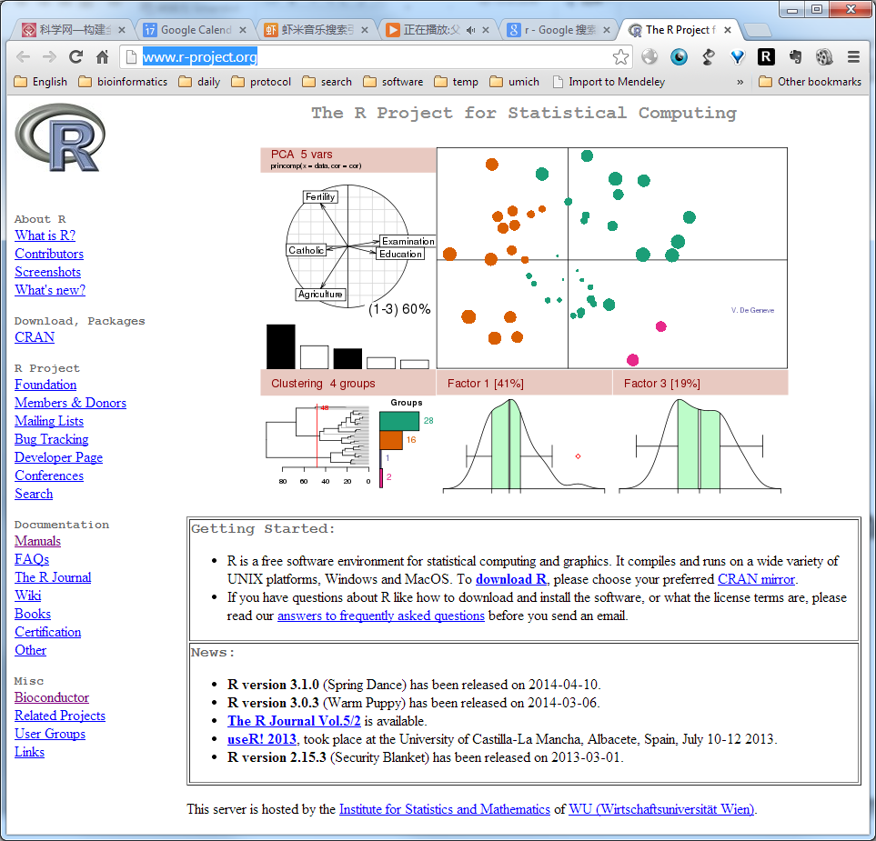
Download R
http://www.r-project.org/

Slide 13

R studio
http://www.rstudio.com/

Slide 14
Exam
Final exam is a report based on the use of statistics in a small project. The report should be 1000 - 2000 words.
Ten-minute (including 2 min Q & A) oral defense of the report in front of the class.

Slide 15
PPT
Will be uploaded to my lab website after each class
qianlab.genetics.ac.cn
Words in red: waiting for your response
Words in green: the beginning of a new example

Slide 16
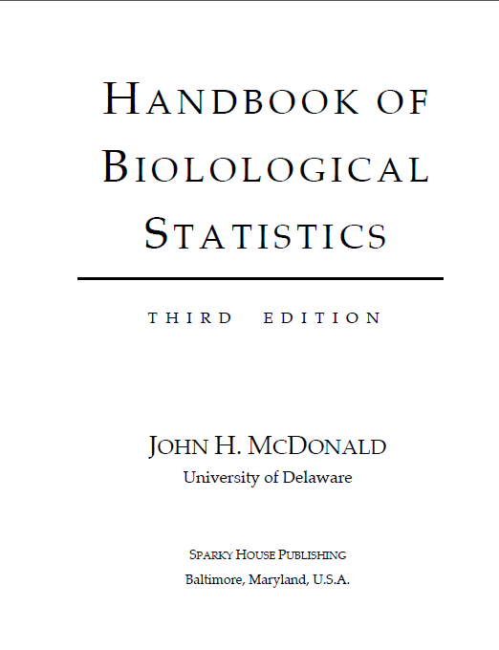
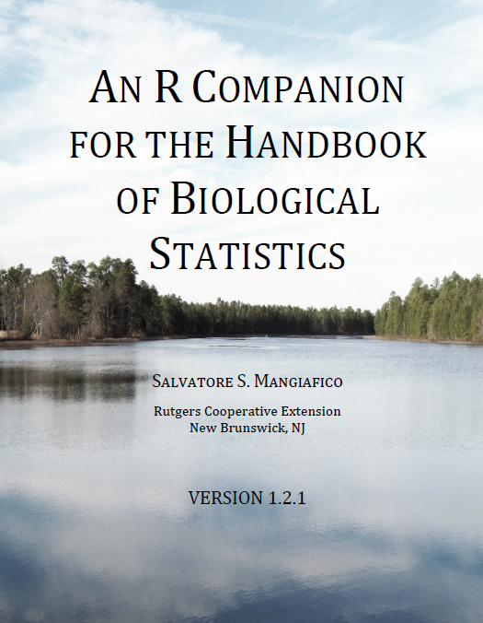
Textbooks

Slide 17
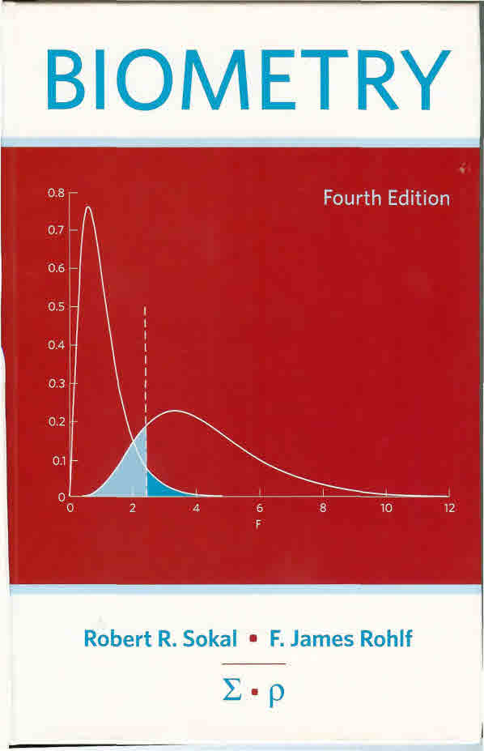
Textbook
Handbook of Biological Statistics
www.biostathandbook.com/HandbookBioStatThird.pdf
An R companion for the handbook of biological statistics
rcompanion.org/documents/RCompanionBioStatistics.pdf
Other reference:
Biometry
by Sokal & Rohlf
What is a p-value anyway?
By Andrew Vickers

Slide 18
Before next class
Handbook of Biological Statistics
Any relevant materials on pages 1-28 (before class II)
An R companion for the handbook of biological statistics
Pages 1-13 (before class II)

Slide 19
Your introduction

Slide 20
Statistics is the base of most sciences
The definition of the modern science?

Slide 21
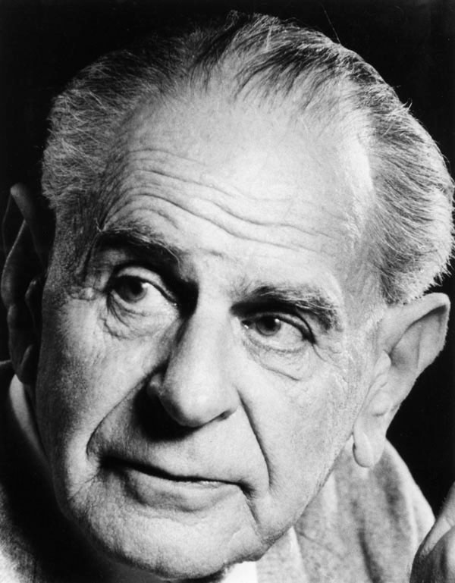
What is science?
A theory in the empirical sciences can never be proven, but it can be falsified, meaning that it can and should be scrutinized by decisive experiments.
Hypothesis testing
Karl Popper 1902-1994

Slide 22
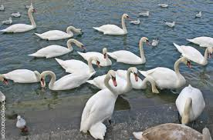
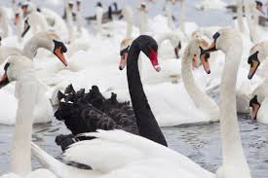
All swans are white

Slide 23
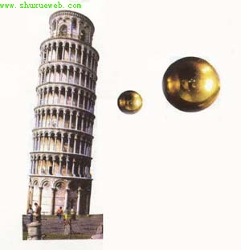
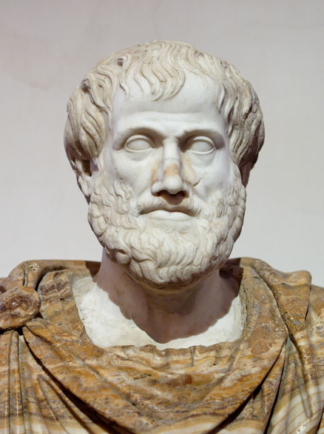
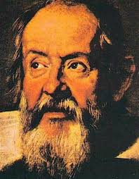
Science is about rejecting null hypothesis
Aristotle
Galilei
Leaning Tower Pisa

Slide 24
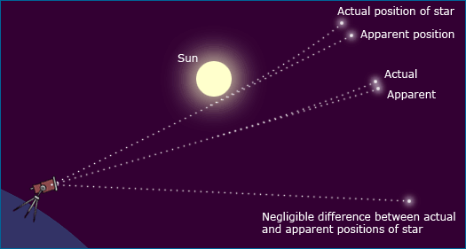
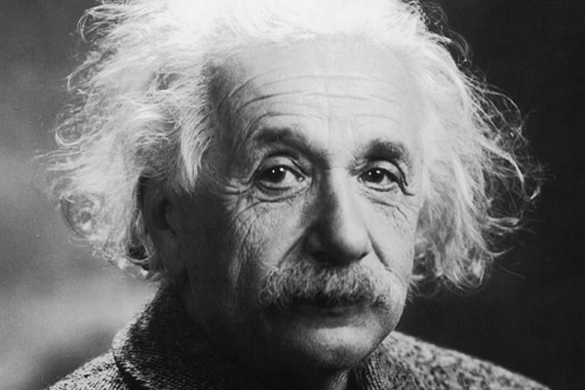
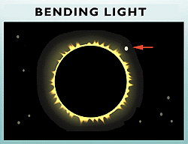
Science is about rejecting null hypothesis
Einstein
Eclipse

Slide 25
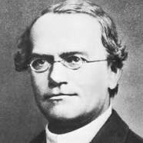
In biology
In genetics
Mixing of traits
Mendelian genetics
Two copy of genes that can be separated in the next generation, generating the 3:1 ratio
Other examples?
Mendel

Slide 26
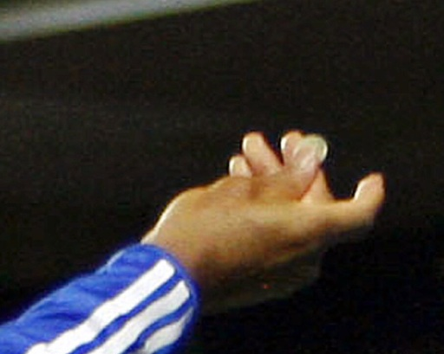
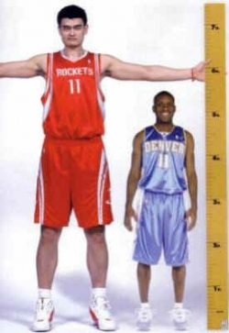

Deterministic vs stochastic events
Deterministic events
Stochastic events
If I toss a coin, I will get a face up
I will get up in the tomorrow morning
A child will grow up
Head or tail?
The exact time point (minute and second) I would wake up naturally
The height and weight of the child
Other examples?

Slide 27
Phenomena in biology
Are likely to be stochastic, compared to physical phenomena
In physical world
Sun rises
Planet moves
Water boils

Slide 28
In Biology
Weight and height
Disease
Life span
The outcome of your exam
Reason?

Slide 29
Reasons of stochasticity in life
Traits are determined by both genes and environments
Environment is heterogeneous
Most traits are affected by multiple genes
Each gene has a minor impact
Developmental strategy (body plan)
Life sciences contains a huge number of factors, which makes stochasticity everywhere.

Slide 30
Regression to the mean
In statistics, regression toward (or to) the mean is the phenomenon that if a variable is extreme on its first measurement, it will tend to be closer to the average on its second measurement
An positive gene in your screen may not appear in the next time.
The best student in the collage could become ordinary later in his/her career
Why?

Slide 31
How do we describe stochastisity?
Distribution!

Slide 32
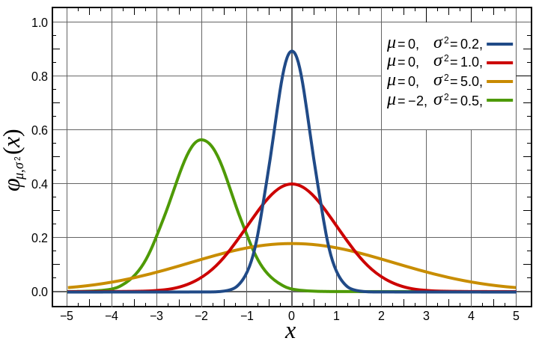
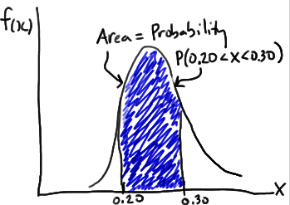
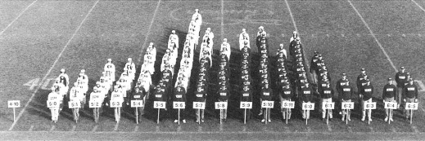
Density function

Slide 33
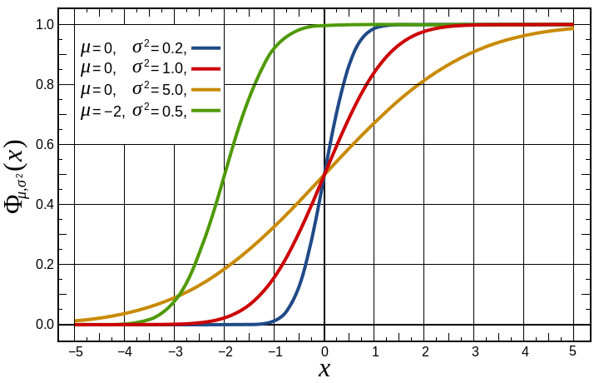
Density function
Cumulative density function

Slide 34
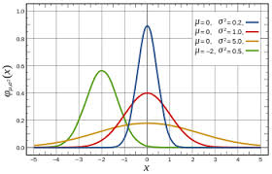
Normal distribution
The bell shape
Appears everywhere in biology
Why?
Traits are determined by both genes and environments
Many genes with minor effects
Additivity
What if not?

Slide 35
Normal distribution
The bell shape
Appears everywhere in biology
Why?
Traits are determined by both genes and environments
Many genes with minor effects
Additivity
What if not?

Slide 36
The probability of a person taller than 1.9 meter
If the distribution of height follows normal distribution, with mean = 1.75 and standard deviation = 0.06

Slide 37
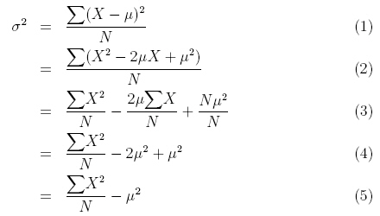
Descriptive statistics
Algebraic Mean (μ)
Variance (σ²)
Standard deviation (σ)

Slide 38
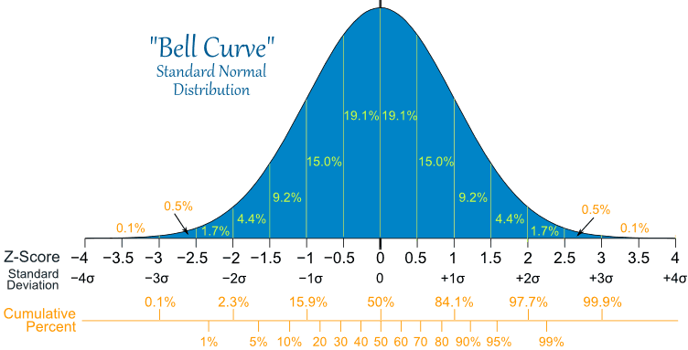
Normal distribution

Slide 39
The probability of a person taller than 1.9 meter
If the distribution of height follows normal distribution, with mean = 1.75 and standard deviation = 0.05
P = 1- “NORMDIST(1.9, 1.75, 0.05, 1)”
=0.6%

Slide 40
The height is more than 1.9 meter
If the distribution of height follows normal distribution, with mean = 1.75 and standard deviation = 0.05
What is the probability of less than 1.2 meter?

Slide 41
The height is more than 1.9 meter
If the distribution of height follows normal distribution, with mean = 1.75 and standard deviation = 0.05
What is the probability of less than 1.2 meter?
What if this number is different from your intuition?

Slide 42
The probability of a person taller than 1.9 meter
If the distribution of height follows normal distribution, with mean = 1.75 and standard deviation = 0.05
What is the probability of being between 1.7 and 1.75?

Slide 43
Can you draw
A density curve of standard normal distribution in Excel?
A cumulative density curve of standard normal distribution in Excel?

Slide 44
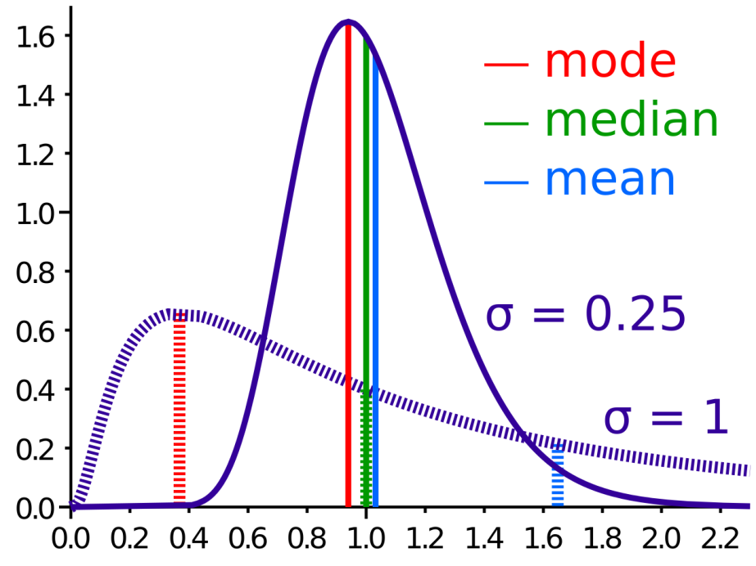
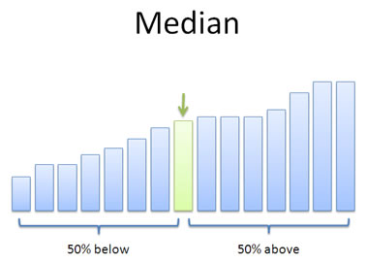
Bill Gates’ visit to a bar
Median

Slide 45
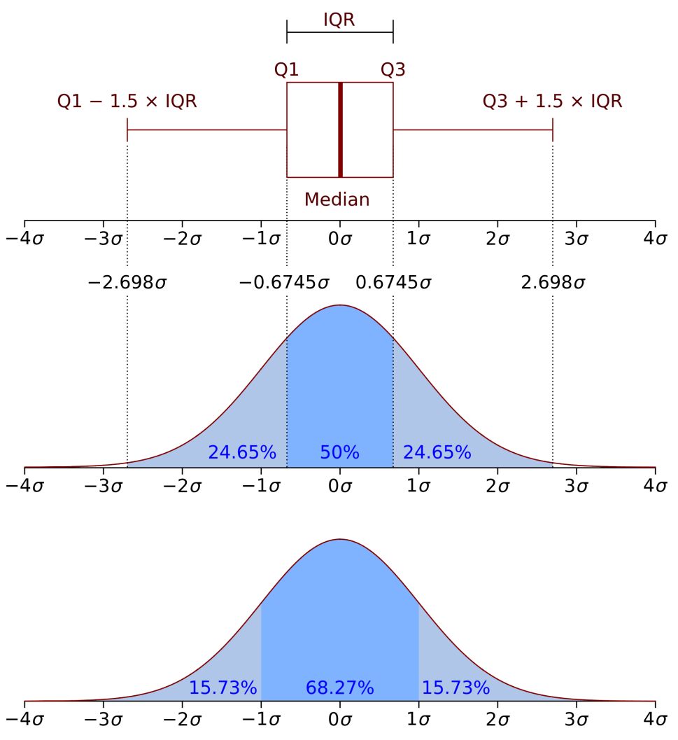
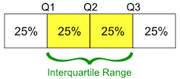
Bill Gates’ revisit to the bar
Boxplot
Interquartile range

Slide 46
How do we treat stochastic data
At a summer tea party in Cambridge, England, a guest states that tea poured into milk tastes different from milk poured into tea. Her notion is shouted down by the scientific minds of the group.
But one man, Ronald Fisher, proposes to scientifically test the hypothesis.

Slide 47
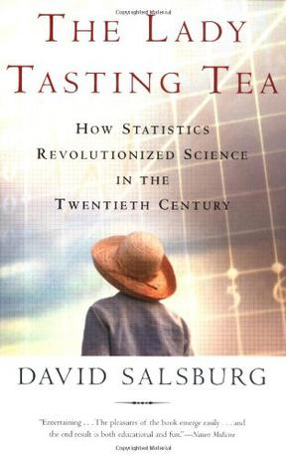
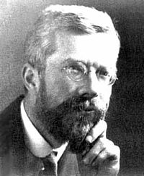

Slide 48
How to test the hypothesis?
H₀: There is not difference on order of milk and tea

Slide 49
How to test the hypothesis?
H₀: There is not difference on order or milk and tea
10 cups of drink
Mixed blind to the lady
Let the lady tell the order of milk and tea
If H₀ is correct, what is the probability the lady get all 10 guess correct?

Slide 50
How to test the hypothesis?
If H₀ is correct, what is the probability that the lady got all 10 guesses correct?

Slide 51
How to test the hypothesis?
If H₀ is correct, what is the probability the lady get all 10 guesses correct? 0.1%
It is unlikely that event with such low probability happened in a single test. Thus, the most likely scenario is that H₀ is incorrect, and there is difference between two orders.

Slide 52
What is a P-value?
The p-value is defined as the probability of obtaining a result equal to or "more extreme" than what was actually observed, assuming that the model is true.
P-value can be used in statistics to reject a null hypothesis

Slide 53
What if…
Among 10 tests, the lady succeeded for 8 of them?

Slide 54
Binomial distribution
First child, Boy or Girl
Second, B or G
Third, B or G
Eight possibilities:
BBB, BBG, BGB, BGG, GBB, GBG, GGB, GGG
What is the probability of having 2 B in 3 children?

Slide 55
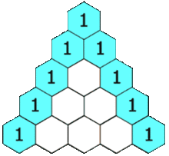
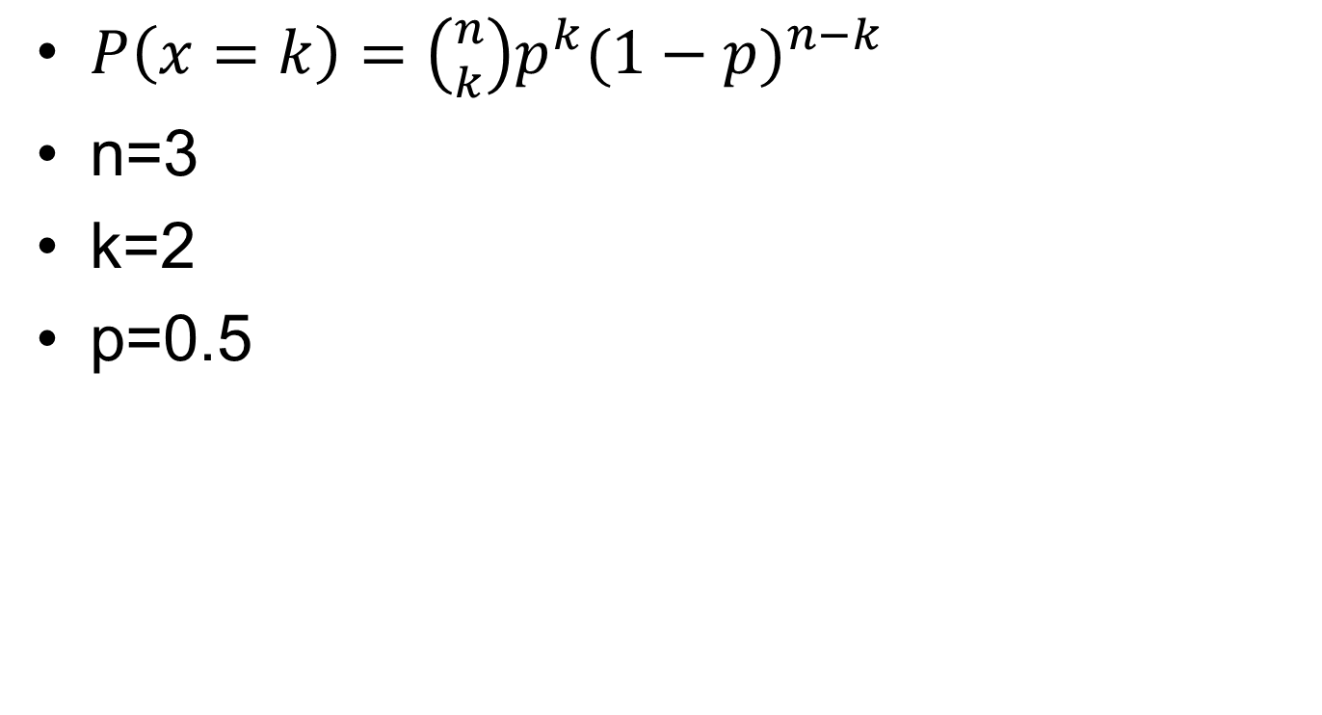
Binomial distribution
$P\left(x=k\right)=\left({n \atop k}\right)p^{k}{(1−p)}^{n−k}$
n=3
k=2
p=0.5

Slide 56
What if…
Among 10 tests, the lady succeeded for 8 of them?
What is the p-value?

Slide 57
Probability estimation
Alternatively, we can estimate the probability of success (E)
In this case 80%
We can get 95% confidence interval (CI)
If 0.5 is out of CI, we conclude a difference between the order

Slide 58
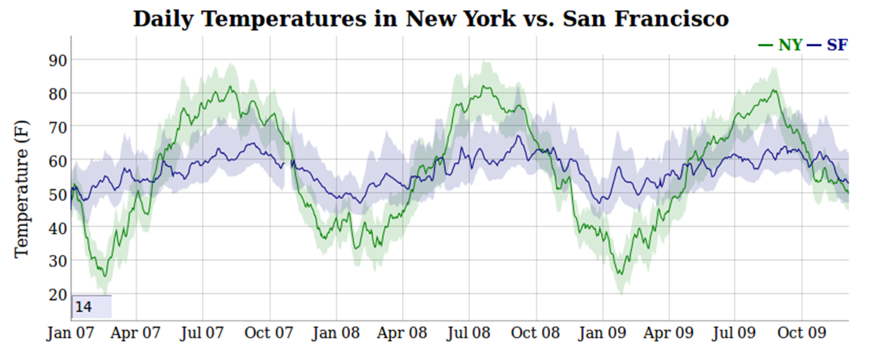
Confidence interval

Slide 59
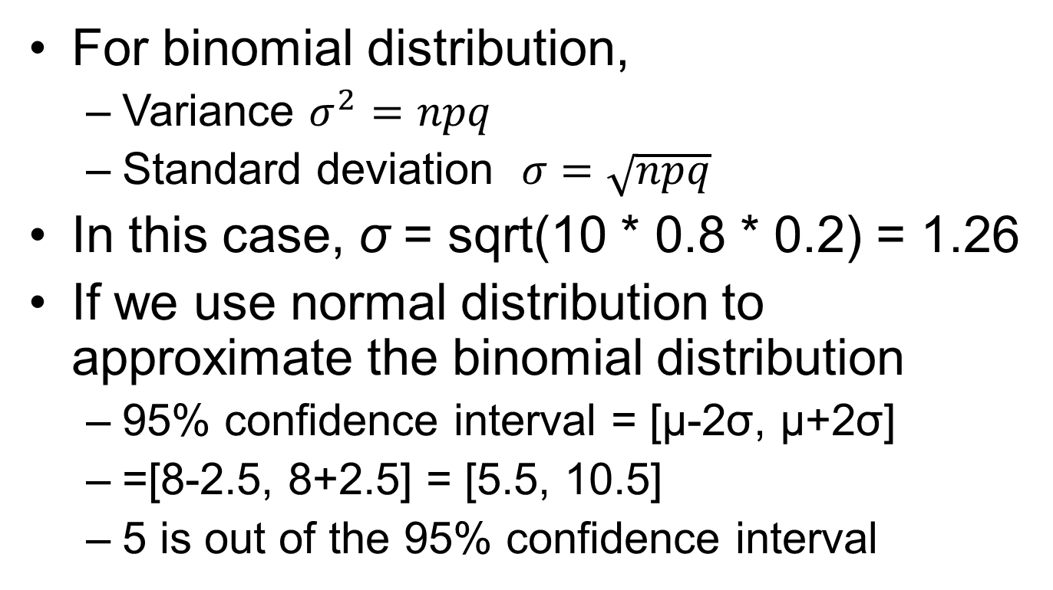
How to calculate confidence interval?
For binomial distribution,
Variance $σ^{2}=npq$
Standard deviation $σ=\sqrt{npq}$
In this case, σ = sqrt(10 * 0.8 * 0.2) = 1.26
If we use normal distribution to approximate the binomial distribution
95% confidence interval = [μ-2σ, μ+2σ]
=[8-2.5, 8+2.5] = [5.5, 10.5]
5 is out of the 95% confidence interval

Slide 60
Law of large number
The estimate of the probability 0.8 may not be accurate …
The larger the sample size, the more accurate our estimate is.
So that we could potentially distinguish 50% from 60%

Slide 61
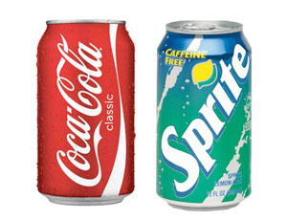
Applications of such idea
Hold your nose, and you may not be able to tell coke from sprite

Slide 62
Is a drug effective or not?
Other examples?

Slide 63
Number of left handed people
If the probability of left handed people is 5% in a population, what is the probability of a 50-student class containing exact 1 left handed people?

Slide 64
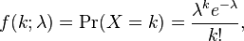
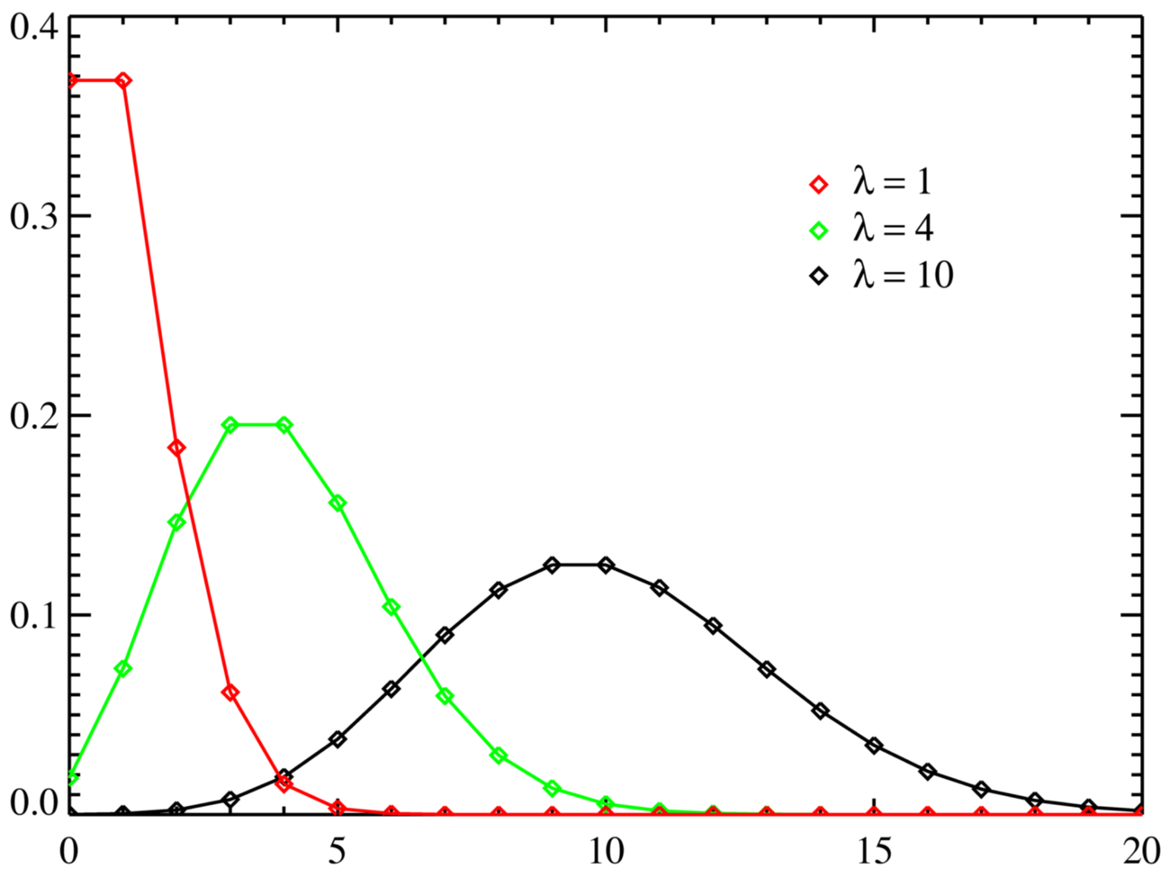
Poisson distribution
λ = mean = variance

Slide 65
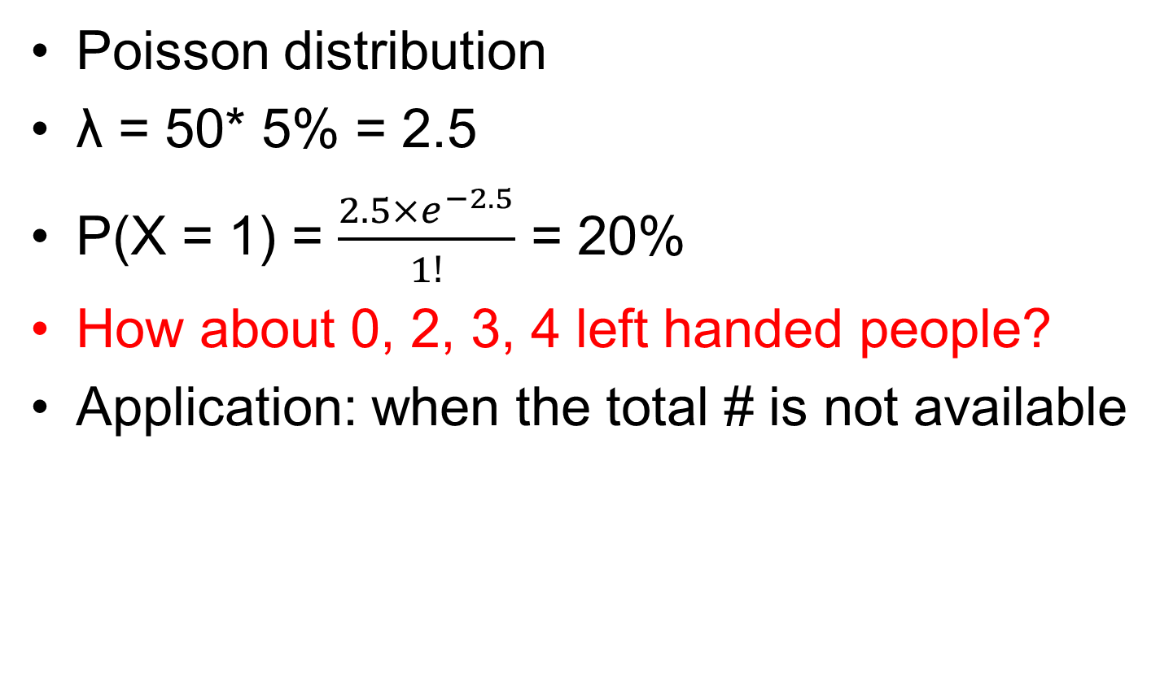
Number of left handed people
Poisson distribution
λ = 50* 5% = 2.5
P(X = 1) = $\frac{2.5×e^{−2.5}}{1!}$ = 20%
How about 0, 2, 3, 4 left handed people?
Application: when the total # is not available

Slide 66
Uranium(²³⁵U)’ radiation
Neutron
Rate 1/sec
The probability of having exactly 1 radiation event in the next sec?

Slide 67
Luria-Delbrück experiment
Question: Did the mutation to resistance happen
BECAUSE of the presence of a virus, or even
BEFORE adding the virus to the culture?

Slide 68
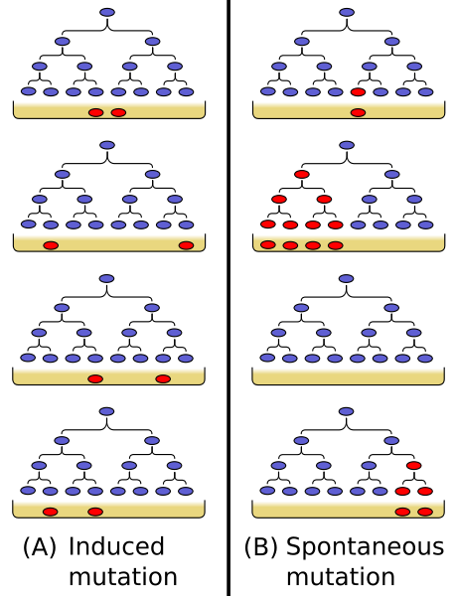

Slide 69
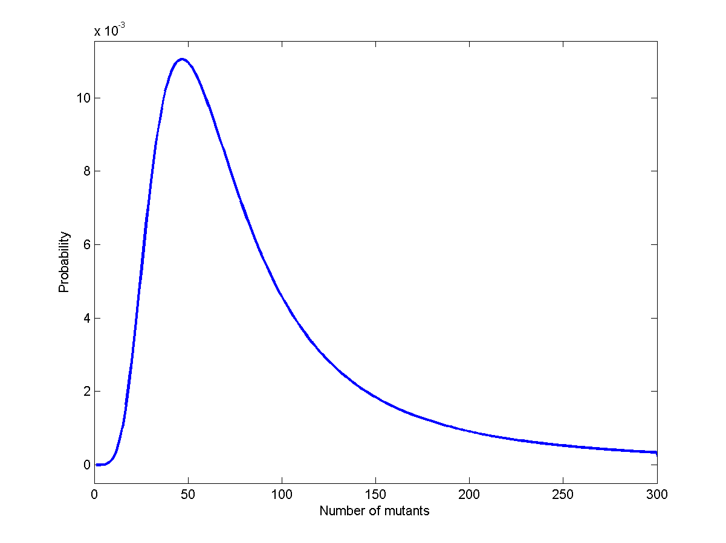

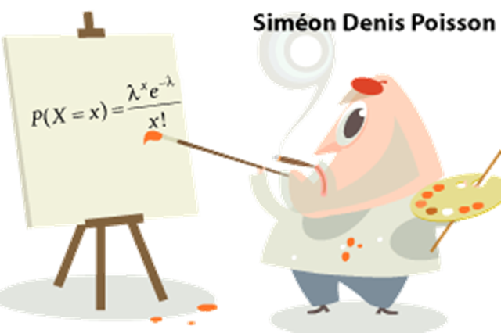
Poisson distribution
Luria-Delbrück distribution

Slide 70
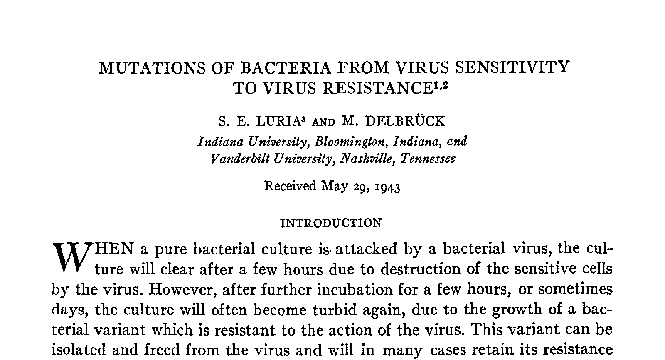

Slide 71
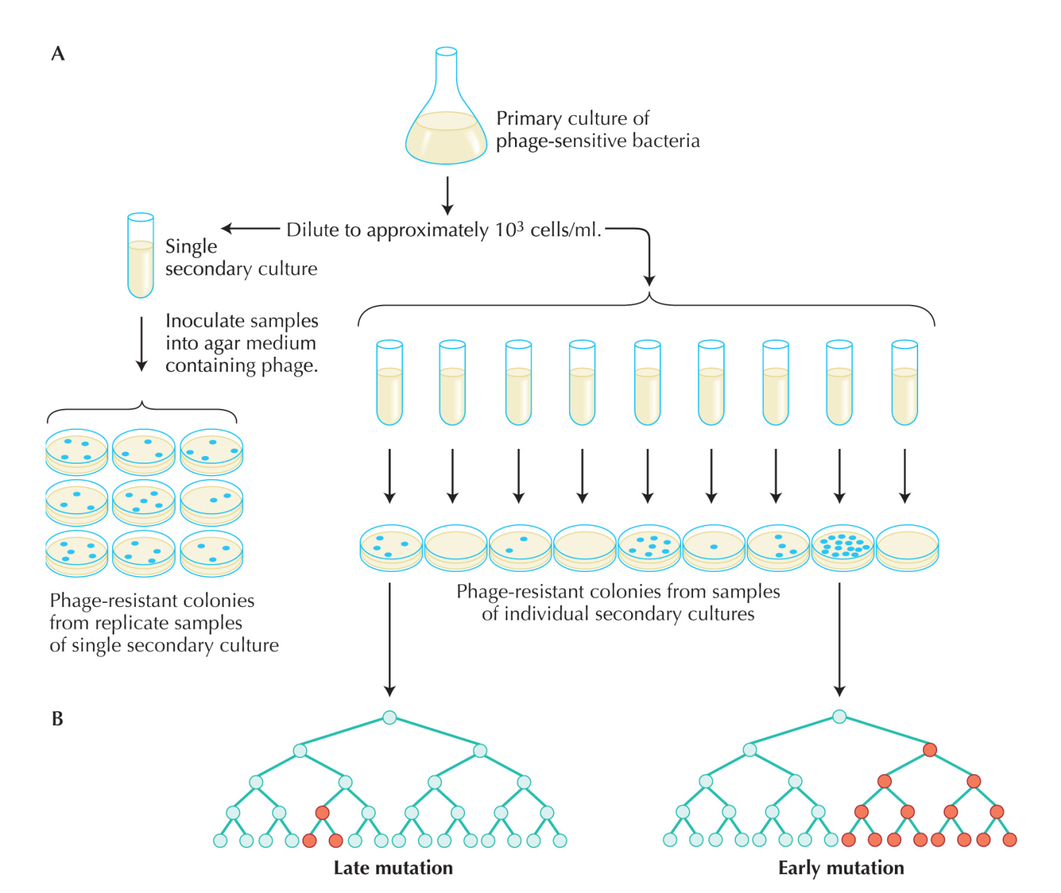
Luria-Delbrück experiment

Slide 72
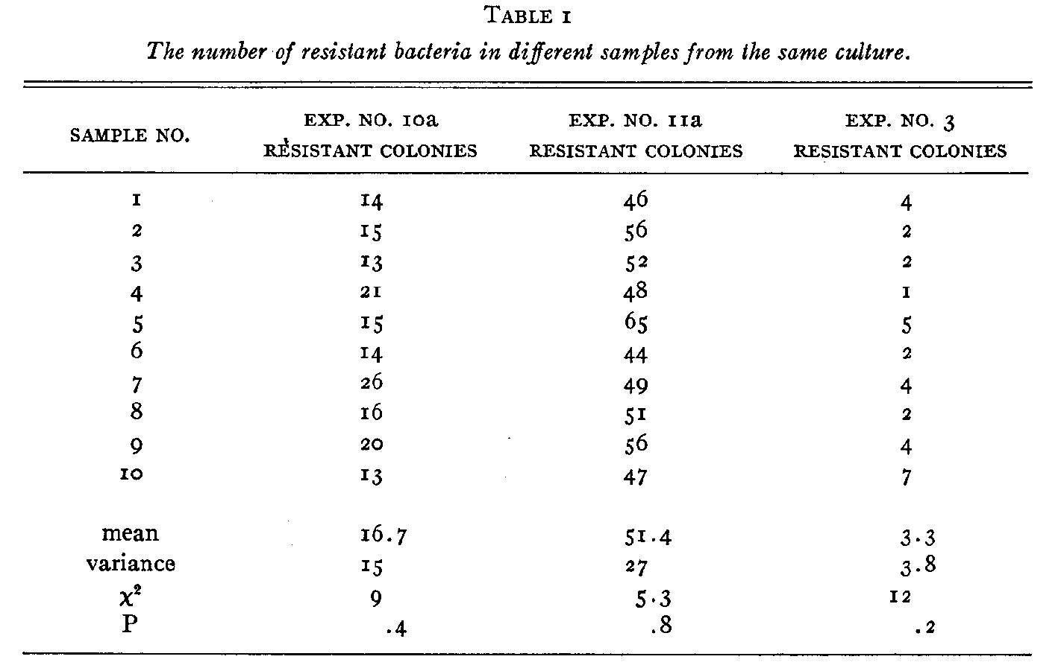

Slide 73


Slide 74


Slide 75



Slide 76



Slide 77
Intuition is extremely important in statistics

Slide 78


Blaise Pascal
1623-1662
Pascal's principle

Slide 79
Geek’s joke
One day, Einstein, Newton, and Pascal meet up and decide to play a game of hide and seek. Einstein volunteered to be “It.” As Einstein counted, eyes closed, to 100, Pascal ran away and hid, but Newton stood right in front of Einstein and drew a one meter by one meter square on the floor around himself. When Einstein opened his eyes, he immediately saw Newton and said “I found you Newton,” but Newton replied,

Slide 80
Einstein, Newton, and Pascal Play Hide and Seek
“No, you found one Newton per square meter. You found Pascal!”.

Slide 81

Pascal’s Problem
The rule of the game
Two people toss the coin one by one
Player A wins when s/he gets 3 “head”
Player B wins when s/he gets 3 “tail”
The game has to stop when A gets 2 “head” and B gets 1 “tail” because of King’s call
How to split the bet?

Slide 82
Opinions
B: A gets 2/3 and B gets 1/3
A needs one more “head”, P = 1/2
B needs two more “tails”, P = 1/4
A: A gets 3/4 and B gets 1/4
B wins only when B gets two “tails” P = 1/4
Otherwise, A wins P = 3/4
Who is correct?

Slide 83
Conclusion
A: A gets 3/4 and B gets 1/4

Slide 84

Monty Hall problem
Suppose you're on a game show, and you're given the choice of three doors: Behind one door is a car; behind the others, goats. You pick a door, say No. 1, and the host, who knows what's behind the doors, opens another door, say No. 3, which has a goat. He then says to you, "Do you want to pick door No. 2?" Is it to your advantage to switch your choice?
Your guess?

Slide 85
Monty Hall problem
If the car is not behind door 3, the probabilities of being behind door 1 and door 2 are equal
P = ½ for both.

Slide 86







Solution 1
1/3
1/3
1/3

Slide 87


Solution 2

Slide 88
Intuition: Consider 10000 doors …
You chose door 1
The host open 9998 doors for you, and none of them have cars behind
Do you switch?

Slide 89
Monty Hall problem
Switch it!

Slide 90
The probability of the same birthday in a class
Consider a class with 50 people
What is the probability that at least two students have the same birthday?
Your guess?

Slide 91
The probability that all have different birthday
The first person: 1
The second person: 364/365
The third person: 363/365
…
The 50th person: 316/365
P = 0.03

Slide 92
The answer
The probability that all have different birthdays
P = 0.03
The probability that at least two students have the same birthday
1 – P =0.97

Slide 93
The success of an experiment
Two people A and B are doing an experiment in my lab
According to the history records, the successful rate for A is 0.8, and that for B is 0.7
Each of them does the experiment once
What is the probability of at least one success?

Slide 94
The success of an experiment
Consider the probability both of them fail
P = 1- 0.2 * 0.3 = 0.94

Slide 95
The success of an experiment
Consider the probability both of them fail
P = 1- 0.2 * 0.3 = 0.94
Any problems here?

Slide 96
The success of an experiment
Consider the probability both of them fail
P = 1- 0.2 * 0.3 = 0.94
Any problems here?
It depends on whether the two people are doing experiments independently!
Do they use the same set of reagents?
If true, then A’s failure increases the probability of B’s failure

Slide 97
The conditional probability
P(A|B)
The probability of A given B
The probability of girl given the first child is a boy in the family
P(the second child is a girl | the first child is a boy)
If independent P (2nd girl | 1st boy) = P (girl)

Slide 98
Probability of infection
A test can detect 95% of the people with infection (true positive)
There is 1% probability of false positive
The frequency of a infection is 0.5%
What is the probability of infection, given a positive result in the test

Slide 99



Bayesian theorem
$P\left(A_{i} \right| B)= \frac{P\left(A_{i}\right)P\left(B \right| A_{i})}{\sum_{i=1}^{∞}{P\left(A_{i}\right)P\left(B \right| A_{i})}}$
A_{i} = infected
B = positive in the test
P (A_{i} | B)

Slide 100
Autosomal single-locus disease
Patients
Normal individuals
?

Slide 101
Autosomal single-locus disease
Patients
Normal individuals
?

Slide 102
The probability of 4th girl in the family, given the first 3 are all girls
Your opinion?

Slide 103
Genetics or stochasticity
Model I: for some genetic reasons, only sperms with X chromosome survive.
Model II: the birth of sons and daughters are equally likely
For a family with 3 daughters, which model is more likely?

Slide 104
Genetics or stochasticity
Model I: for some genetic reasons, only sperms with X chromosome survive.
Model II: the birth of sons and daughters are equally likely
How to calculate it quantitatively?

Slide 105
Genetics or stochasticity
Model I: for some genetic reasons, only sperms with X chromosome survive.
Model II: the birth of sons and daughters are equally likely
LOD score: log₁₀ of odds
LOD = log₁₀(P(obs. | model I)/ P(obs. | model II))

Slide 106
Genetics or stochasticity
Model I: Genetics
Model II: By chance
LOD = log₁₀(P(obs. | model I)/ P(obs. | model II))
P(obs. | model I) = 1
P(obs. | model II) = 8
LOD =log₁₀(1/8) = 0.9
Threshold: >3 or <-3

